Slide 1
Establishing the learning goals, a look at the programme
Peter Willendrup

Slide 2
Learning goals:
Learn McStas basics
Build and operate simple instrument models, source + optics + sample + detector
Learn basics of instrument-optimisation for your type of instrument
Add Mantid / NeXus capabilities
Get a better idea of what you want to do with McStas, how to do it, how to get help
Get up-to-speed with latest developments and advanced features
Enable your independent work with McStas

Slide 3
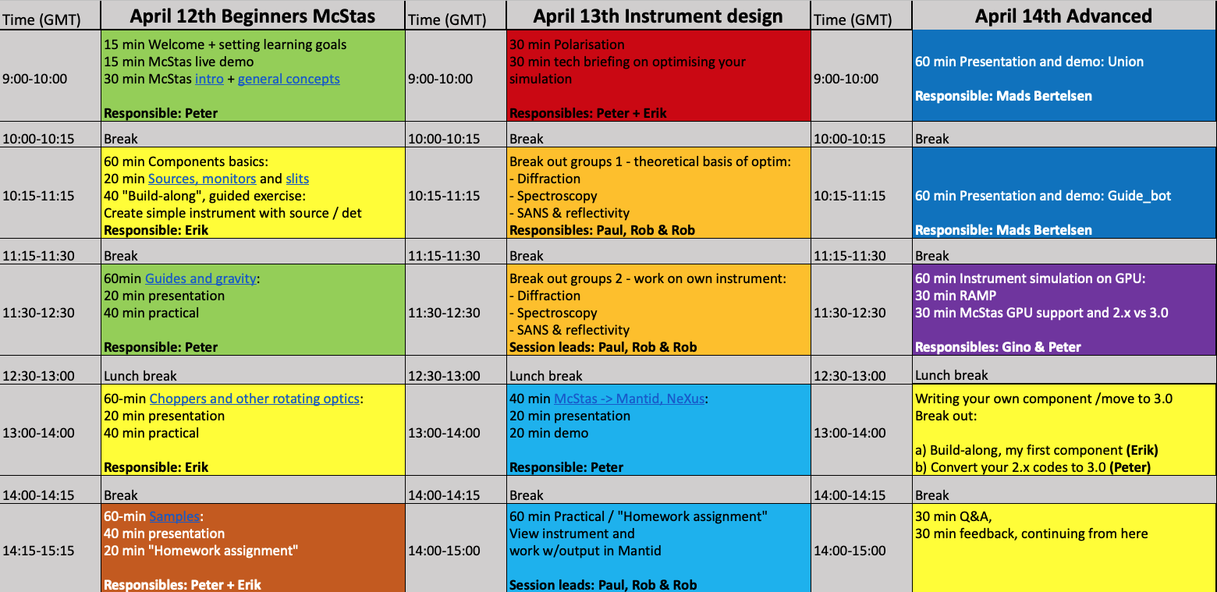
School programme

Slide 4
School programme - day 1
Intro lecture, general principles
In “cookbook” sections, think ahead toward your own project: * Which neutron source * What optics * What sample - K.I.S.S. for now
Lectures + “recipe” exercises
Sample-lecture, including “advanced McStas grammar… + “homework”: Start off / work on your own instrument-project

Slide 5
School programme - day 2
Lectures on polarisation and instrument optimisation technicals
Discipline-specific parallel-sessions + work-sessions. Continue on “homework”
Mantid-intermezzo, lecture and demo
Add Mantid backend to your “homework” - or simply continue on it.

Slide 6
School programme - day 3, fancy-fancy “new stuff”
Lecture: Union subsystem - sample environments and backgrounds…
Lecture: Guide_bot, guide optimisation “robot”
Lectures, speed-up your future: Using GPU’s with RAMP or McStas 3
2 x breakouts: a) Write your first component b) Port your instrument / component to McStas 3
Continue “homework" Give us feedback Ask your last in-school questions

Slide 7
For the exercise-based work-sessions
You will benefit from working in pairs, 2 > 1
Take turns being the “coder” and the “parallel processor”

Slide 8
Let’s get to it!

